Slide 1



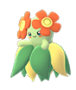
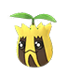



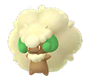


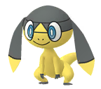
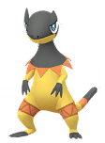


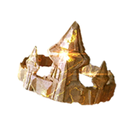
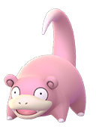
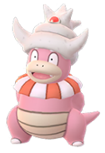
Pokemon Go
Evolve Item Chart Information
Gloom
100 Candy’s
Bellossom
Sun Stone
Pokemon
Sunkern
50 Candy’s
Sunflora
Cottonee
50 Candy’s
Whimsicott
Petilil
50 Candy’s
Lilligant
Helioptile
50 Candy’s
Heliolisk
King's Rock
Pokemon
Poliwhirl
100 Candy’s
Politoed
Slowpoke
50 Candy’s
Slowking
Page 1 of 2

Slide 2
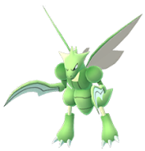
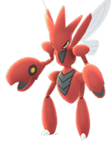

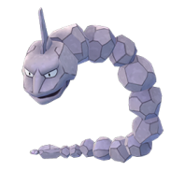
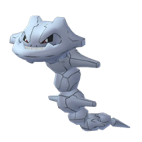



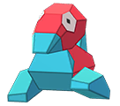
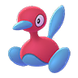
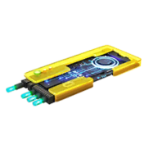
Pokemon Go
Evolve Item Chart Information
Metal Coat
Pokemon
Scyther
50 Candy’s
Scizor
Onix
50 Candy’s
Steelix
Dragon Scale
Pokemon
Seadra
100 Candy’s
Kingdra
Up Grade
Pokemon
Porygon
50 Candy’s
Porygon 2
Page 2 of 2

